Slide 1

“MASTERING THE JOB HUNT”
Resume and Cover Letter
Contents
Importance
Resume
Content
Sample
Cover Letter
Content
Sample

Slide 2
“MASTERING THE JOB HUNT”
Resume and Cover Letter
Contents
Importance
Resume
Content
Sample
Cover Letter
Content
Sample

Slide 3
Importance
Resume
Cover Letter
01
06
First Impression
Personal Connection to the Role
02
07
Summary of Qualifications
Showcase Communication Skills
03
08
Structured & Easy to Scan
Adds Depth to Resume Content
04
09
Highlights Career Progression
Demonstrates Effort and Interest
05
10
Tailored to Specific Roles
Opportunity to Address Gaps/Shifts

Slide 5
Resume

Slide 6
Resume
Work Experience
Use reverse chronological order and emphasize achievements over responsibilities
Objective / Summary
Briefly highlight career goals or key accomplishments relevant to the role
Skills
Showcase relevant technical and soft skills tailored to the job
ATS Friendly Design
Use clean formatting, clear headings, and avoid graphics to ensure compatibility with Applicant Tracking Systems
Conciseness
Keep the resume focused, ideally 1-2 pages, with clear, impactful language
Education
Include degrees, institutions, and any relevant coursework or honours

Slide 7
Resume
Work Experience
Use reverse chronological order and emphasize achievements over responsibilities
Objective / Summary
Briefly highlight career goals or key accomplishments relevant to the role
Skills
Showcase relevant technical and soft skills tailored to the job
ATS Friendly Design
Use clean formatting, clear headings, and avoid graphics to ensure compatibility with Applicant Tracking Systems
Conciseness
Keep the resume focused, ideally 1-2 pages, with clear, impactful language
Education
Include degrees, institutions, and any relevant coursework or honours

Slide 8
Resume
Work Experience
Use reverse chronological order and emphasize achievements over responsibilities
Objective / Summary
Briefly highlight career goals or key accomplishments relevant to the role
Skills
Showcase relevant technical and soft skills tailored to the job
ATS Friendly Design
Use clean formatting, clear headings, and avoid graphics to ensure compatibility with Applicant Tracking Systems
Conciseness
Keep the resume focused, ideally 1-2 pages, with clear, impactful language
Education
Include degrees, institutions, and any relevant coursework or honours

Slide 9
Resume
Work Experience
Use reverse chronological order and emphasize achievements over responsibilities
Objective / Summary
Briefly highlight career goals or key accomplishments relevant to the role
Skills
Showcase relevant technical and soft skills tailored to the job
ATS Friendly Design
Use clean formatting, clear headings, and avoid graphics to ensure compatibility with Applicant Tracking Systems
Conciseness
Keep the resume focused, ideally 1-2 pages, with clear, impactful language
Education
Include degrees, institutions, and any relevant coursework or honours

Slide 10
Resume
Work Experience
Use reverse chronological order and emphasize achievements over responsibilities
Objective / Summary
Briefly highlight career goals or key accomplishments relevant to the role
Skills
Showcase relevant technical and soft skills tailored to the job
ATS Friendly Design
Use clean formatting, clear headings, and avoid graphics to ensure compatibility with Applicant Tracking Systems
Conciseness
Keep the resume focused, ideally 1-2 pages, with clear, impactful language
Education
Include degrees, institutions, and any relevant coursework or honours

Slide 11
Sample
Work Experience
Use reverse chronological order and emphasize achievements over responsibilities
Objective / Summary
Briefly highlight career goals or key accomplishments relevant to the role
Skills
Showcase relevant technical and soft skills tailored to the job
ATS Friendly Design
Use clean formatting, clear headings, and avoid graphics to ensure compatibility with Applicant Tracking Systems
Conciseness
Keep the resume focused, ideally 1-2 pages, with clear, impactful language
Education
Include degrees, institutions, and any relevant coursework or honours

Slide 12
Work Experience
Use reverse chronological order and emphasize achievements over responsibilities
Objective / Summary
Briefly highlight career goals or key accomplishments relevant to the role
Skills
Showcase relevant technical and soft skills tailored to the job
Sample
ATS Friendly Design
Use clean formatting, clear headings, and avoid graphics to ensure compatibility with Applicant Tracking Systems
Conciseness
Keep the resume focused, ideally 1-2 pages, with clear, impactful language
Education
Include degrees, institutions, and any relevant coursework or honours

Slide 13
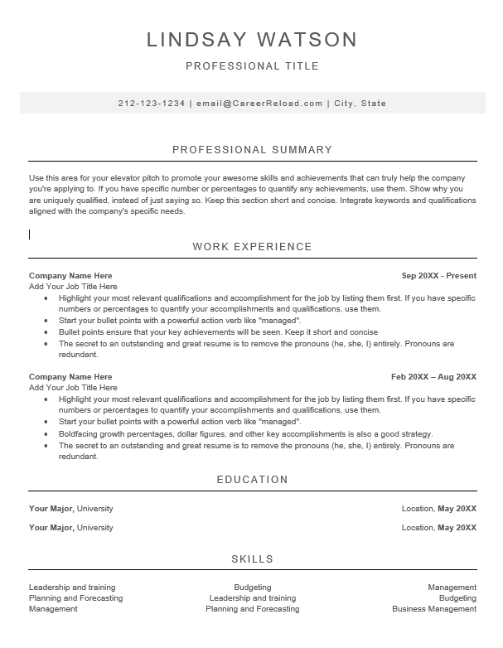

Slide 15
Cover Letter

Slide 16
3
4
2
5
1
6
Salutations
Address the hiring manager by name if possible
Introduction
Briefly introduce yourself, express enthusiasm for the position, and mention how you learned about the role
Body (Skills)
Highlight your relevant skills and experiences, explaining how they align with the job and company needs
Why this Company?
Mention why you’re excited about the company, its mission, or specific projects
Closing
Reiterate your enthusiasm, thank them for considering your application, and express your eagerness to discuss your qualifications further

Slide 17
3
4
2
5
1
6
Header
Include Your Contact information and the employer’s details
Salutations
Address the hiring manager by name if possible
Introduction
Briefly introduce yourself, express enthusiasm for the position, and mention how you learned about the role
Body (Skills)
Highlight your relevant skills and experiences, explaining how they align with the job and company needs
Why this Company?
Mention why you’re excited about the company, its mission, or specific projects
Closing
Reiterate your enthusiasm, thank them for considering your application, and express your eagerness to discuss your qualifications further

Slide 18
3
4
2
5
1
6
Salutations
Address the hiring manager by name if possible
Header
Include Your Contact information and the employer’s details
Introduction
Briefly introduce yourself, express enthusiasm for the position, and mention how you learned about the role
Body (Skills)
Highlight your relevant skills and experiences, explaining how they align with the job and company needs
Why this Company?
Mention why you’re excited about the company, its mission, or specific projects
Closing
Reiterate your enthusiasm, thank them for considering your application, and express your eagerness to discuss your qualifications further

Slide 19
3
4
2
5
1
6
Introduction
Briefly introduce yourself, express enthusiasm for the position, and mention how you learned about the role
Header
Include Your Contact information and the employer’s details
Salutations
Address the hiring manager by name if possible
Body (Skills)
Highlight your relevant skills and experiences, explaining how they align with the job and company needs
Why this Company?
Mention why you’re excited about the company, its mission, or specific projects
Closing
Reiterate your enthusiasm, thank them for considering your application, and express your eagerness to discuss your qualifications further

Slide 20
3
4
2
5
1
6
Body (Skills)
Highlight your relevant skills and experiences, explaining how they align with the job and company needs
Header
Include Your Contact information and the employer’s details
Salutations
Address the hiring manager by name if possible
Introduction
Briefly introduce yourself, express enthusiasm for the position, and mention how you learned about the role
Why this Company?
Mention why you’re excited about the company, its mission, or specific projects
Closing
Reiterate your enthusiasm, thank them for considering your application, and express your eagerness to discuss your qualifications further

Slide 21
3
4
2
5
1
6
Why this Company?
Mention why you’re excited about the company, its mission, or specific projects
Header
Include Your Contact information and the employer’s details
Salutations
Address the hiring manager by name if possible
Introduction
Briefly introduce yourself, express enthusiasm for the position, and mention how you learned about the role
Body (Skills)
Highlight your relevant skills and experiences, explaining how they align with the job and company needs
Closing
Reiterate your enthusiasm, thank them for considering your application, and express your eagerness to discuss your qualifications further

Slide 22
3
4
2
5
1
6
Closing
Reiterate your enthusiasm, thank them for considering your application, and express your eagerness to discuss your qualifications further
Header
Include Your Contact information and the employer’s details
Salutations
Address the hiring manager by name if possible
Introduction
Briefly introduce yourself, express enthusiasm for the position, and mention how you learned about the role
Body (Skills)
Highlight your relevant skills and experiences, explaining how they align with the job and company needs
Why this Company?
Mention why you’re excited about the company, its mission, or specific projects

Slide 23
3
4
2
5
1
6
Header
Include Your Contact information and the employer’s details
Salutations
Address the hiring manager by name if possible
Introduction
Briefly introduce yourself, express enthusiasm for the position, and mention how you learned about the role
Body (Skills)
Highlight your relevant skills and experiences, explaining how they align with the job and company needs
Why this Company?
Mention why you’re excited about the company, its mission, or specific projects

Slide 24
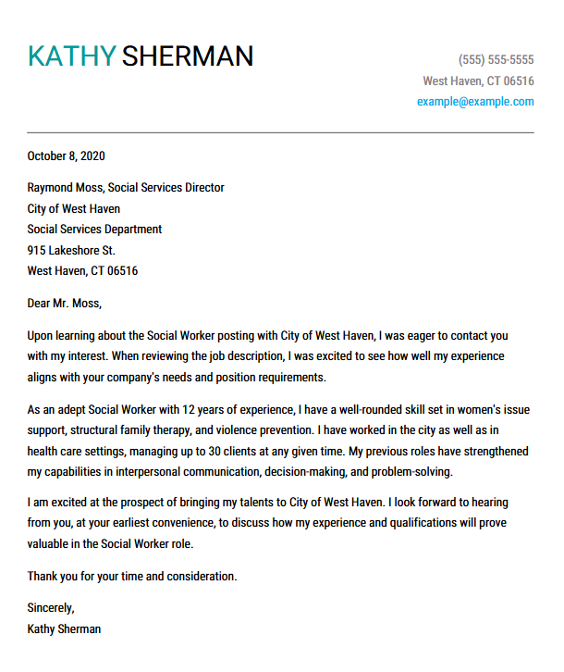
Sample

